Slide 1
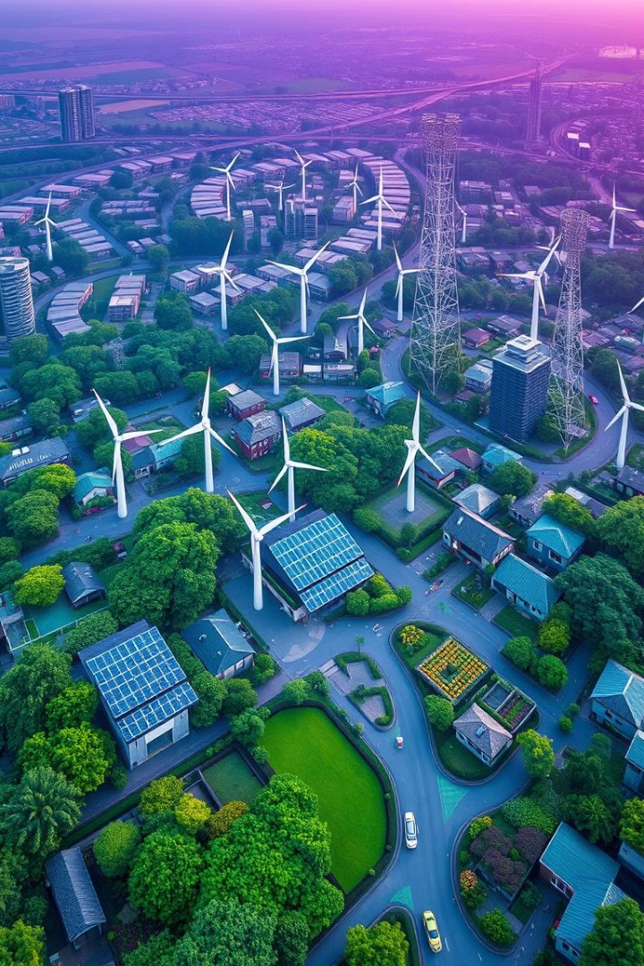
E.A.R.T.H. - Empowering Communities for a Sustainable Future
E.A.R.T.H. is a revolutionary community-driven platform that harnesses the power of AI and gamification to inspire environmental action and drive meaningful change. By fostering collaboration and empowering citizens, we're building a more sustainable future, one community at a time.

Slide 2
Connecting Communities to Address Local Needs
Interactive Community Map
Collaborative Problem-Solving
Data-Driven Insights
Our AI-powered analysis identifies trends and highlights areas in need of attention, guiding smart decision-making.
Users can easily pinpoint environmental issues and share updates on our interactive map, creating a real-time visualization of sustainability challenges.
Citizens, government agencies, and organizations work together to identify solutions and coordinate efforts for maximum impact.

Slide 3
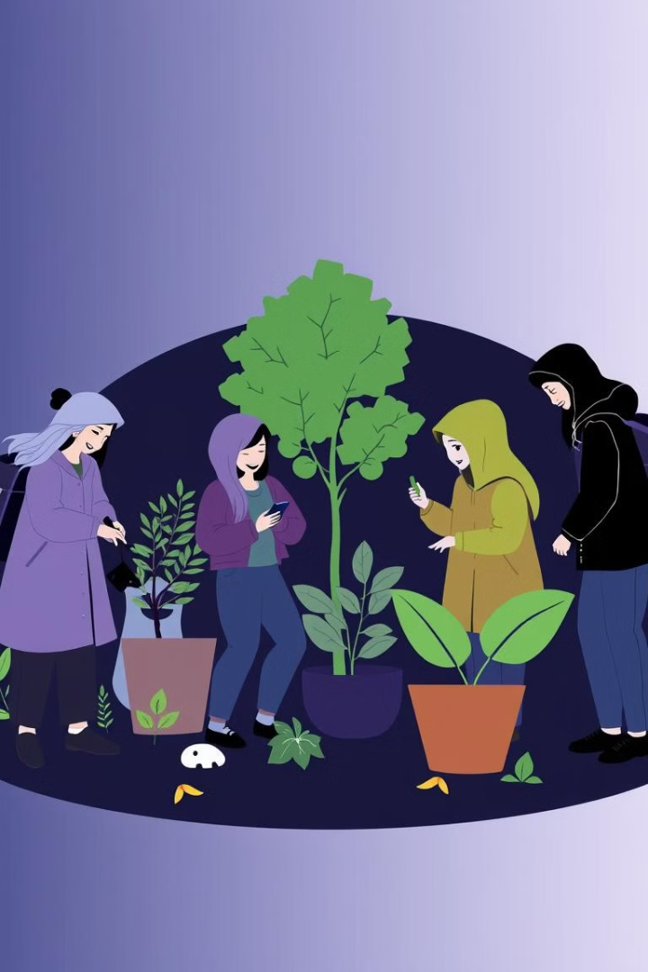




Harnessing the Power of Gamification
Earn Badges
Users can earn badges and points for completing eco-challenges, fostering a sense of friendly competition and community engagement.
Community Leaderboards
Track your progress and see how your community stacks up against others, inspiring everyone to do their part.
Unlock Rewards
Redeem your points for exclusive rewards and perks, further incentivizing sustainable behaviors.
Participation Matters
Every contribution, no matter how small, makes a difference and is recognized within the E.A.R.T.H. community.

Slide 4
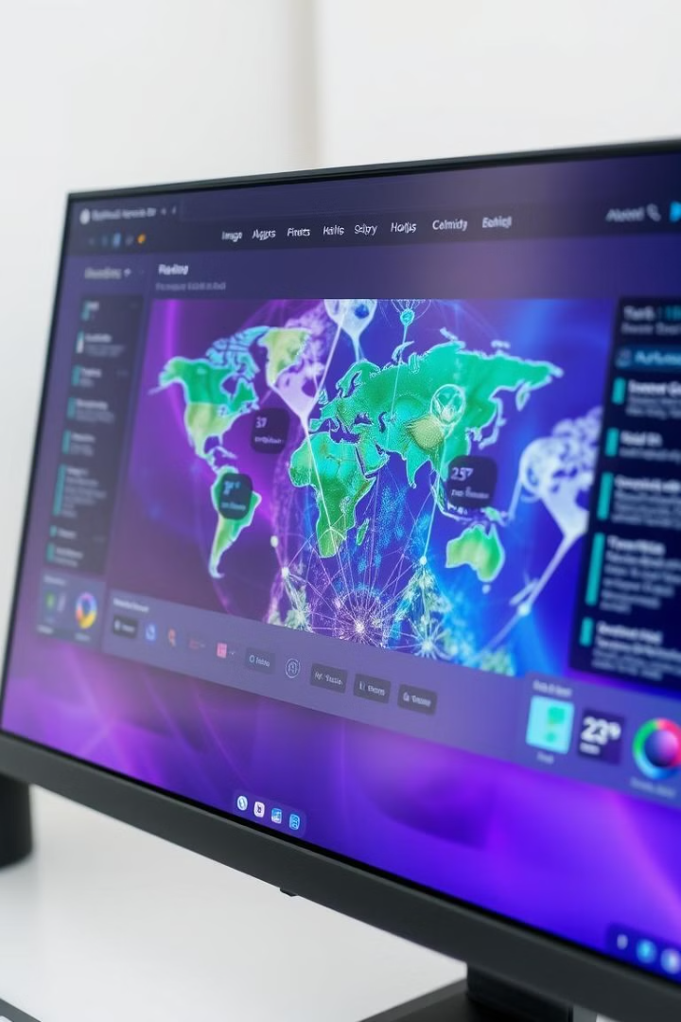
AI-Powered Environmental Insights
1
Automated Image Analysis
Our advanced AI, Gemini, can automatically identify environmental problems from user-uploaded photos, providing valuable data.
2
Trend Identification
Gemini analyzes community data to uncover trends and patterns, highlighting areas in need of greater attention.
3
Targeted Interventions
With AI-driven insights, government agencies and organizations can take informed, data-driven action to address sustainability challenges.

Slide 5
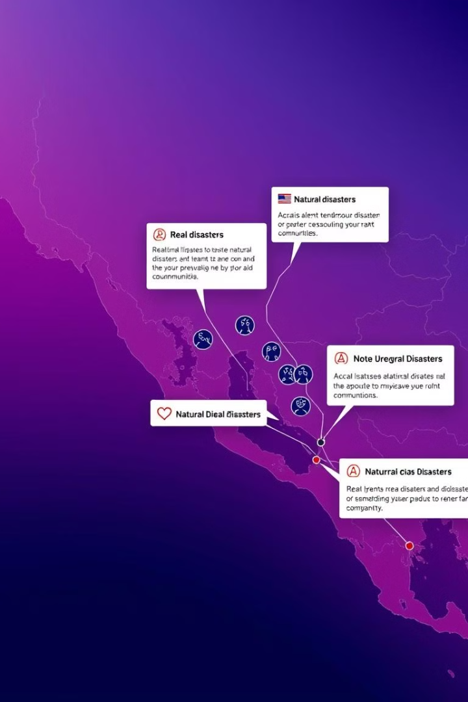



Disaster Response and Preparedness
Real-Time Alerts
Receive immediate notifications about environmental emergencies and natural disasters, allowing for swift response.
Coordinated Relief Efforts
Utilize E.A.R.T.H.'s tools to organize and streamline relief efforts, ensuring resources reach those in need quickly.
Proactive Planning
Analyze data to identify vulnerable areas and develop targeted disaster preparedness strategies for communities.

Slide 6

Empowering Collaboration and Transparency
Open Data Access
E.A.R.T.H. will open-source select data to promote transparency and enable government agencies and organizations to conduct their own research and surveys.
API Integration
Our platform will seamlessly integrate with government APIs, allowing for the exchange of valuable environmental data and insights.
Shared Responsibility
By fostering collaboration and shared ownership, we can collectively tackle environmental challenges and drive sustainable change.

Slide 7

Join the E.A.R.T.H. Movement
1
Ignite Change
Be a catalyst for environmental action in your community by joining the E.A.R.T.H. platform.
2
Grow the Network
Invite your friends, neighbors, and local organizations to get involved and contribute to our shared mission.
3
Achieve Sustainability
Together, we can create a more sustainable future by empowering communities to take meaningful steps towards environmental stewardship.

